Slide 1
WELCOME ALL OF
Kabilan.t
FED05

Slide 2
TRANSFORM Property

Slide 3
The transform property applies a 2D or 3D
transformation to an element.
This property allows you to rotate, scale,
move, skew, etc., elements.

Slide 4
2D Transforms Methods
Translate ()
Rotate ()
scaleX ()
scaleY ()
Scale ()
skewX ()
skewY ()
Skew ()
Matrix ()

Slide 5
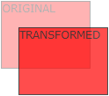
translat
div { transform: translate(50px, 100px); }

Slide 6
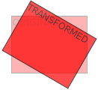
rotate
div { transform: rotate(20deg); }

Slide 7
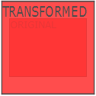
scale
div { transform: scale(2, 3);
transform: scaleX(2);
transform: scaleY(3); }

Slide 8
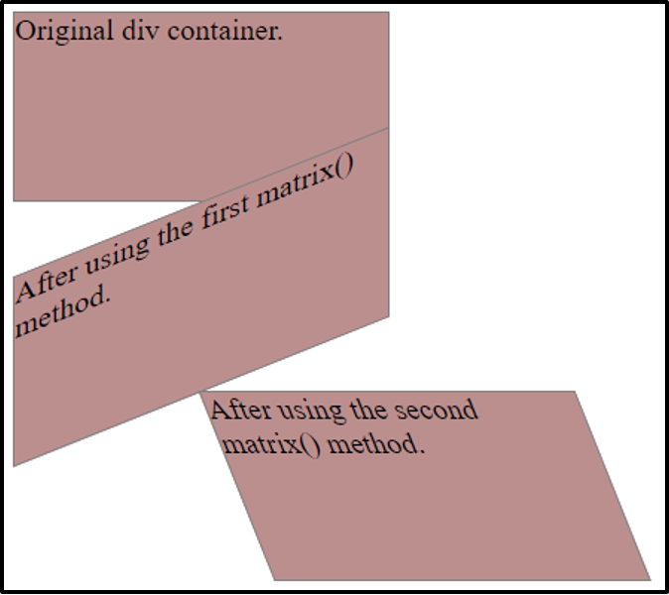
skew
div { transform: skewX(20deg);
transform: skewY(20deg);
transform: skew(20deg, 10deg); }

Slide 9
matrix
div { transform: matrix(1, -0.3, 0, 1, 0, 0); }
matrix(scaleX(), skewY(), skewX(), scaleY(), translateX(), translateY())

Slide 10

3d transform

Slide 11
3D Transforms Methods
rotateX()
rotateY()
rotateZ()

Slide 12

Rotate x
#div { transform: rotateX(150deg); }

Slide 13

Rotate y
#div { transform: rotateY(150deg); }

Slide 14
Rotate z
#div { transform: rotateZ(90deg); }

Slide 15
Rotate x,y,z….

Slide 16
Thanks all

